Slide 1
7. Knowledge Graph Creation
John P. McCrae
CT5166

Slide 2
Course structure
9th Sep | Introduction to Knowledge Graphs | 21st Oct | Inductive reasoning
16th Sep | Models for Knowledge Graphs | 28th Oct | KG Creation (no lab on Monday)
23rd Sep | Querying and Serialization | 4th Nov | KG Alignment
30th Sep | Schemas | 11th Nov | Publishing and Linked Open Data
7th Oct | Deductive reasoning | 18th Nov | Linguistic Linked Open Data
14th Oct | No Lecture | 25th Nov | Enterprise Knowledge Graphs

Slide 3

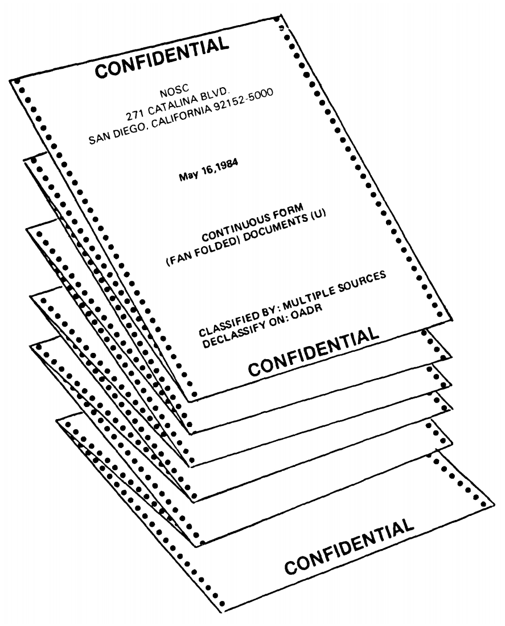
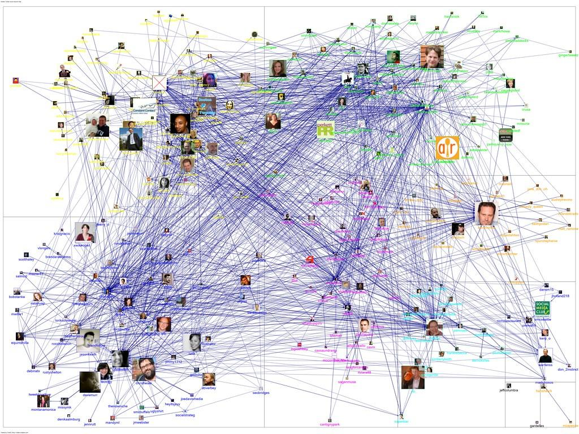
Overview
Ontology Learning is the task of learning an ontology from text
Ontology population/KG extraction is the task of finding a knowledge graph for an ontology
Ontology Learning
Ontology Population

Slide 4
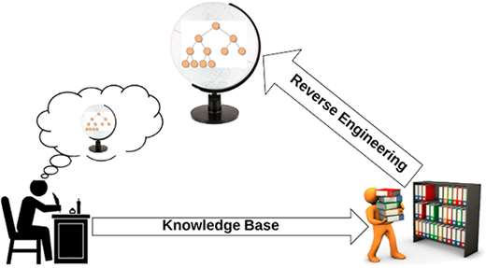
Ontology Learning
Reverse engineering the knowledge in an author’s head from the text they have written
Image from https://academic.oup.com/database/article/doi/10.1093/database/bay101/5116160

Slide 5
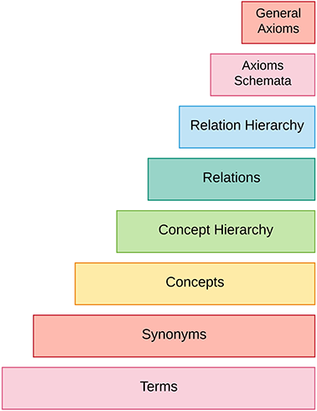
Ontology
There are many things to learn in an ontology!
Ontology Learning is quite hard!

Slide 6
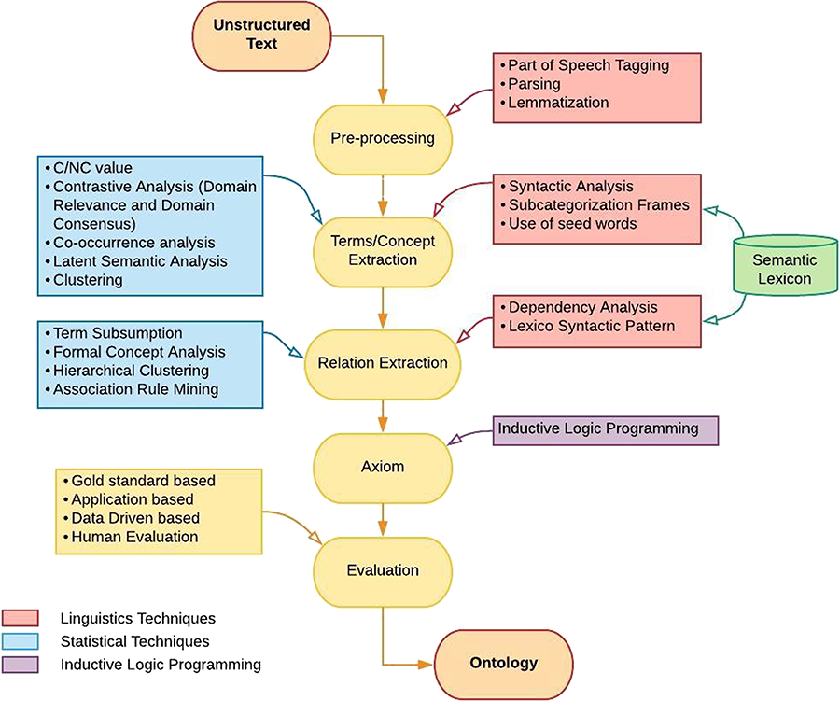

Methodologies of Ontology Learning
Notes:
Figure 3 Methodology of ontology learning.
Unless provided in the caption above, the following copyright applies to the content of this slide: © The Author(s) 2018. Published by Oxford University Press.This is an Open Access article distributed under the terms of the Creative Commons Attribution License (http://creativecommons.org/licenses/by/4.0/), which permits unrestricted reuse, distribution, and reproduction in any medium, provided the original work is properly cited.

Slide 7
Concept
Extraction

Slide 8
Preprocessing
As seen in CT5120, a first step is normally to process the texts we have:
Tokenization
Part-of-speech tagging
Lemmatization
Parsing (optional)

Slide 9
Term Recognition
Terms in ontologies tend to be noun phrases:
‘Ireland’
Often with prepositional phrases
‘Republic of Ireland’
Adjectives can be important too
‘African Swine Fever’

Slide 10
Pattern-based Term Extraction
*
*
*
JJ
NN
NNS
NNP
DT
JJ
NN
NNS
NNP
NN
NNP
NNS
IN
NN
NNP
NNS
46th
President
of
the United States

Slide 11
Example Corpus
GameStop shares sank early today as trading platforms including Robinhood and Interactive Brokers restricted trading.
The video game retailer, along with AMC Entertainment and other stocks soared this week in a social media-driven trading frenzy that shook stock markets.
GameStop, the video game chain whose 1,700% rally has been at the heart of the frenzy in the past week, lost half its value in early trading.
It said restricted stocks also included BlackBerry, Koss and Express.
The dramatic jumps in the stock price of companies including GameStop, BlackBerry Ltd and AMC drew more calls for regulatory scrutiny.
Source: https://www.rte.ie/news/business/2021/0128/1193714-gamestop-stock-retreats-as-restrictions-introduced/

Slide 12
Tagged Corpus
How many terms can you find?
NNP NNS VBD RB NN IN NN NNS VBG NNP CC NNP NNP VBD NN .
DT NN NN NN , IN IN NNP NNP CC JJ NNS VBD DT NN IN DT JJ JJ NN NN IN VBD NN NNS .
NNP , DT NN NN NN WP$ CD NN NN VBZ VBN IN DT NN IN DT NN IN DT JJ NN , VBD PDT PRP$ NN IN JJ NN .
PRP VBD JJ NNS RB VBD NNP , NNP CC NNP .
DT JJ NNS IN DT NN NN IN NNS VBG NNP , NNP NNP CC NNP VBD JJR NNS IN JJ NN .

Slide 13
List of terms
Gamestop, Gamestop shares, today, today as trading platforms, trading platforms, trading, platforms, Robinhood, interactive brokers, brokers.
video game retailer, video, video game, game retailer, retailer, AMC Entertainment, AMC, Entertainment, other stocks, stocks, social media-driven trading frenzy, media-driven trading frenzy, social media-driven trading, media-driven trading, trading frenzy, frenzy
etc...

Slide 14
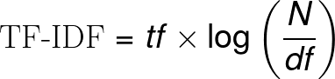
TF-IDF
A basic approach is to use Term Frequency - Inverse Document Frequency (TF-IDF) to rank the terms:
What is the TF-IDF of “video game”? Treat each sentence as an independent document
Notes:
\text{TF-IDF} = tf \times \log\left(\frac{N}{df} \right )

Slide 15
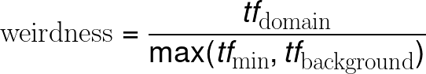
Weirdness
Another approach is to compare with a ‘background corpus’, e.g., Wikipedia
It is normally a good idea to have a minimal frequency in the background corpus

Slide 16
Inclusion
Terms should be reasonably consistent and not appear in many other terms - the longest term is the best
To solve this, we introduce c-Value that penalizes terms for the number of other terms included in it

Slide 17
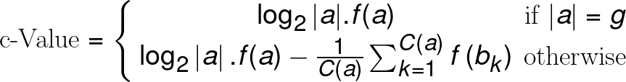
c-Value
g - Maximum term length
f(a) - Frequency of term a in corpus
C(a) - Number of longer terms that include a
b_{k} - The strings that include a
What is the c-Value of “game” and “video game” (g=3)

Slide 18
Named Entity Recognition
Named Entity Recognition can also be useful (see CT5120)
Only recognizes names (‘Gamestop’) not terms (‘video game retailer’)
In OWL, these are termed ‘individuals’.

Slide 19
Other methods
Co-occurrence methods
Latent Semantic Analysis
Term clustering
Deep learning approaches
Multiple approaches can be combined by supervised and unsupervised approaches

Slide 20
Relation Extraction

Slide 21
Approaches to relation extraction
Mention-level/Example-based
Rely on a single section of text to infer a relation, e.g.,
“Barack Obama is married to Michelle Obama”
High precision, low recall
Global/Distributional
Use frequency and co-occurrence to infer a relation
“Barack Obama” is often mentioned near “Michelle Obama” they must be related
Low precision, high recall

Slide 22
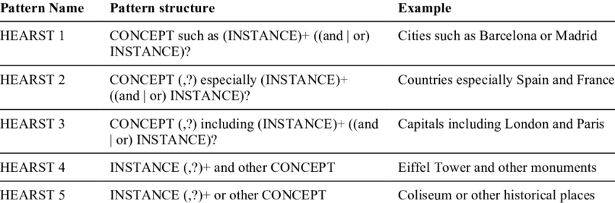
Lexico-syntactic Patterns
Are there any Hearst patterns in our Gamestop corpus?
We can also use simple regular patterns to extract hypernym relations.
Hearst patterns are used for hypernym detection:

Slide 23
Example Corpus
GameStop shares sank early today as trading platforms including Robinhood and Interactive Brokers restricted trading.
The video game retailer, along with AMC Entertainment and other stocks soared this week in a social media-driven trading frenzy that shook stock markets.
GameStop, the video game chain whose 1,700% rally has been at the heart of the frenzy in the past week, lost half its value in early trading.
It said restricted stocks also included BlackBerry, Koss and Express.
The dramatic jumps in the stock price of companies including GameStop, BlackBerry Ltd and AMC drew more calls for regulatory scrutiny.
Source: https://www.rte.ie/news/business/2021/0128/1193714-gamestop-stock-retreats-as-restrictions-introduced/

Slide 24
Distant supervision
We can learn patterns for other relations automatically.
We can use existing knowledge graphs, e.g., a “paw” is a part of a “cat”
Assume all examples indicate the relation
“... the cat’s paw…”
“...the cat raised its paw…”
“...the cat has paws…”

Slide 25
Distant Supervision
Not all patterns will be good… combine this a supervised learning pattern
One feature per pattern, value
is the frequency of the
term.
the X’s Y
X raised its Y
X has Y
2
0
5
true
Snow, Rion, Daniel Jurafsky, and Andrew Y. Ng. "Learning syntactic patterns for automatic hypernym discovery." Advances in Neural Information Processing Systems 17 (2004).

Slide 26
Formal Concept Analysis
 | stands | jumps | barks | miaows | unintended
cat | ✓ | ✓ |  | ✓
dog | ✓ | ✓ | ✓
animal | ✓ | ✓ | ✓ | ✓
table | ✓
purpose |  |  |  |  | ✓
We extract properties based on the verbs and adjectives that the terms frequently occur with

Slide 27
Formal Concept Analysis
Things
The terms can be organized into a lattice
Can be tricky to implement, many models of hierarchical clustering exist
Things that stand:
table
Unintended things: purpose
Things that stand and jump:
animal
Things that stand and work:
human
How to detect relations other than hypernymy with distributional methods?
Things that stand, jump and miaow:
cat
Things that stand, jump and bark:
dog

Slide 28
Axioms

Slide 29
Inductive Logic Programming
Ontologies are not just graphs of knowledge, they contain axioms!
To learn an ontology we also need to learn logical rules

Slide 30
Family Tree Example
Vito
Carmela
Carmela
parent
parent
Connie
mIchael
Kay
cOnnie
parent
We want to learn from two positive examples:
d(o,c) and d(m,i)
Mary

Slide 31
Inductive Logic Programming
1. Write all background knowledge as propositions:
p(o,v) ∧ p(o,c) ∧ p(i,c) ∧ p(m,i) ∧ p(m,k) ∧ m(v) ∧ f(o) ∧ f(c) ∧ m(i) ∧ f(m) ∧ f(k)
2. Assume examples follow from background knowledge
d(o,c) ← p(o,v) ∧ p(o,c) ∧ p(i,c) ∧ p(m,i) ∧ p(m,k) ∧ m(v) ∧ f(o) ∧ f(c) ∧ m(i) ∧ f(m) ∧ f(k)
d(m,i) ← p(o,v) ∧ p(o,c) ∧ p(i,c) ∧ p(m,i) ∧ p(m,k) ∧ m(v) ∧ f(o) ∧ f(c) ∧ m(i) ∧ f(m) ∧ f(k)

Slide 32
Inductive Logic Programming
3. (Anti-unification) Find variables that cover multiple instances x={o,m}, y = {i,c}
d(x,y) ← p(o,v) ∧ p(x,y) ∧ p(i,c) ∧ p(x,y) ∧ p(m,k) ∧ m(v) ∧ f(x) ∧ f(c) ∧ m(i) ∧ f(x) ∧ f(k)
4. Eliminate all propositions not using variables in consequence and duplicates
d(x,y) ← p(x,y) ∧ f(x)
Can you learn a rule from this positive examples:
wife(v,c) and wife(i,k)

Slide 33
Evaluation

Slide 34
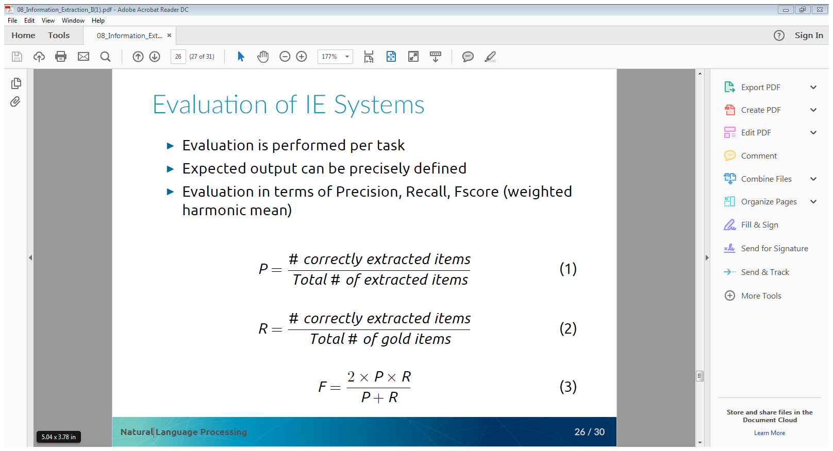
Precision, Recall, F-Measure
For term and relation extraction a typical evaluation uses precision, recall and F-measure
Typically this is based on extracted terms/extracted relation pairs

Slide 35
Challenges for Evaluation
Differences in granularity
May extract correct relations not in gold standard
Animal
Animal
Ontology may still be useful but incomplete
Mammal
vs.
Solution may be ‘application-based evaluation’
Cat
Cat
How do you think you may do an application-based evaluation?

Slide 36
Summary

Slide 37
Summary
Ontologies are complex things to learn from text
Find terms and concepts
Build relationships between them
Learn axioms and rules
Evaluation is also tricky
Evaluation datasets cannot be complete

Slide 38
References
Maedche, A. and Staab, S. (2000) Discovering conceptual relations from text. In: ECAI. Berlin, 321, 27.
Faure, D. and Poibeau , T. 2000. First experiments of using semantic knowledge learned by ASIUM for information extraction task using Intex. In Proceedings of the 1st Workshop on Ontology Learning.
Hahn, U. AND Romacker , M. 2000. Content management in the SyndiKate system: How technical documents are automatically transformed to text knowledge bases. Data Knowl. Eng. 35, 1, 137–159.
Velardi , P., Navigli , R., Cucchiarelli , A., AND Neri , F. 2005. Evaluation of OntoLearn, a methodology for automatic learning of ontologies. In Ontology Learning from Text: Methods, Evaluation and Applications, P. Buitelaar, P. Cimiano, and B. Magnini, Eds. IOS Press, Hershay, PA.
Jiang , X. AND Tan , A. 2010. CRCTOL: A semantic-based domain ontology learning system. J. Am. Soc. Inf. Sci. Technol. 61, 1, 150–168.
Bianca Pereira, Cécile Robin, Tobias Daudert, John P. McCrae, Paul Buitelaar and Pranab Mohanty. Taxonomy Extraction for Customer Service Knowledge Base Construction, Proceedings of the SEMANTicS 2019, (2019).

